Slide 1
Data Analysis of developer survey taken in 2019 about changing technologies
Elisabetta De Vito-Francesco
14.12.2022

Slide 2
OUTLINE

Slide 3




OUTLINE
Executive Summary
Introduction
Problem
Questions for analysis
Methodology
Results
Answers to questions for analysis as Visualizations & Findings and implications
Most used vs most desired languages
Most used vs most desired databases
Developers count by age gender country
Compensation by age gender country
Dashboard
Discussion
Findings & Implications
Conclusion
Appendix
Most used vs desired platforms
Most used vs desired web frames
Number of job postings
Popular languages
Work locations

Slide 4
EXECUTIVE SUMMARY

Slide 5

EXECUTIVE SUMMARY
Problem: data analysis to help identify future skill requirements
Questions analysis: Which are the current technologies trends analysis? Which are the future technologies trends analysis? Which are the demographic analysis?
Methods: Randomized subset of data from an online survey conducted by Stack Overflow website in 2019 (1/10th of the original size). Tools: Jupiter Notebooks, Python, SQL, IBM Cognos Analytics.
Results: Visualization of top 5 current and future languages. Visualization of top 5 current and future databases. Respondents count by age, gender, country. Compensation by age, gender, country, languages.
Discussion: Trends of most used vs most desired for next year languages. Trends of most used vs most desired for next year databases. Developers respondents characteristics by age gender country compensation.
Conclusions: Languages to focus on: JavaScript HTML/CSS Python SQL. Databases to focus on: PostgreSQL MongoDB MySQL. Flatten the disparities between genders in number of developers. Flatten the disparities between genders in compensation of developers
Appendix: Number of job postings per city in USA. Number of job postings per language in USA. Annual average compensation per language. Work location of developers in survey 2019. Most used vs desired for next year platforms. Most used vs desired for next year web frames.

Slide 6
INTRODUCTION

Slide 7

INTRODUCTION Problem
In order to keep pace with changing technologies and remain competitive, a regular data analysis to help identify future skill requirements must be performed.

Slide 8
INTRODUCTION Questions for analysis
In order to keep pace with changing technologies and remain competitive, a regular data analysis to help identify future skill requirements must be performed.
Current technologies trends analysis
Which are the most used technologies by developers in 2019?
Most used languages
Most used databases
Most used platforms (Appendix)
Most used web frames (Appendix)
Which are the most desired technologies by developers to be learnt for the next year?
Most used languages
Most used databases
Most used platforms (Appendix)
Most used web frames (Appendix)
Future technologies trends analysis
Are there any differences in numbers and compensation between developers based on age and origin?
How much do developers earn?
How old are developers?
Where are developers from?
Demographic analysis

Slide 9
INTRODUCTION Questions for analysis
In order to keep pace with changing technologies and remain competitive, a regular data analysis to help identify future skill requirements must be performed.
Which are the most used technologies by developers in 2019?
Most used languages
Most used databases
Most used platforms (Appendix)
Most used web frames (Appendix)
Which are the most desired technologies by developers to be learnt for the next year?
Most used languages
Most used databases
Most used platforms (Appendix)
Most used web frames (Appendix)
Are there any differences in numbers and compensation between developers based on age and origin?
How much do developers earn?
How old are developers?
Where are developers from?

Slide 10
METHODOLOGY

Slide 11

METHODOLOGY Dataset and tools
Dataset
Data from an online survey conducted by Stack Overflow website in 2019.
https://stackoverflow.blog/2019/04/09/the-2019-stack-overflow-developer-survey-results-are-in/ under a ODbL: Open Database License
Randomized subset of the original dataset as 1/10th of the original size.
https://cf-courses-data.s3.us.cloud-object-storage.appdomain.cloud/IBM-DA0321EN-SkillsNetwork/LargeData/m1_survey_data.csv?utm_medium=Exinfluencer&utm_source=Exinfluencer&utm_content=000026UJ&utm_term=10006555&utm_id=NA-SkillsNetwork-Channel-SkillsNetworkCoursesIBMDA0321ENSkillsNetwork21426264-2022-01-01
Tools
Jupyter notebooks → Analysis, RDMS connection, visuals
Python → Pandas for analysis, Matplotlib for visuals
SQL → Queries and analysis
IBM Cognos Analytics → Dashboard visuals

Slide 12

METHODOLOGY Analysis and visuals
Current technologies trends for developers (2019)
Most used languages
Most used databases
Most used platforms (Appendix)
Most used web frames (Appendix)
vs
Future technologies trends for developers (2020)
Most desired languages
Most desired databases
Most desired platforms (Appendix)
Most desired web frames (Appendix)
Demographic analysis
Disparities between genders and age for developers
Number of developer per gender
Compensation per gender
Number of developer per age
Compensation per age
Number of developer per origin country

Slide 13
RESULTS

Slide 14
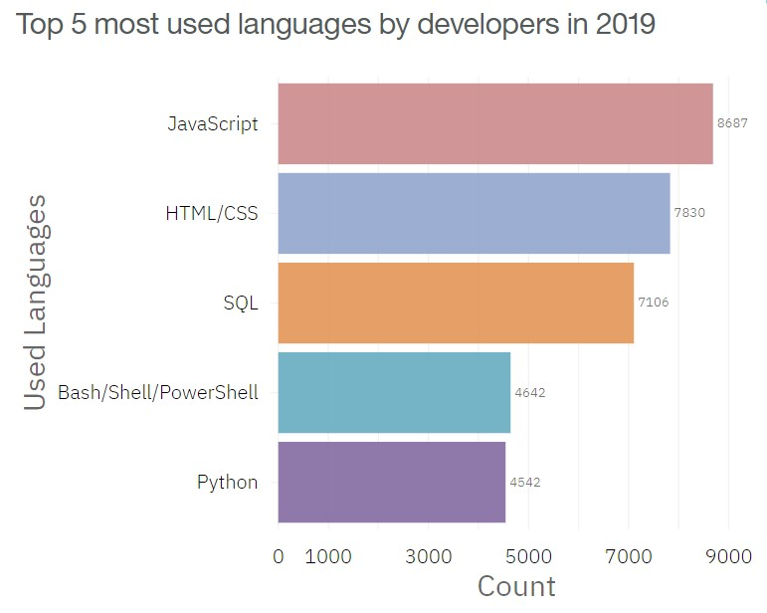
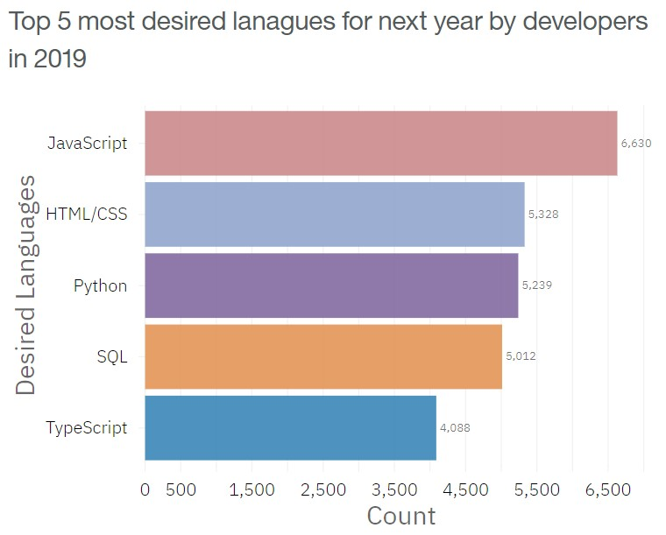
VISUALIZATION Programming language trends
Current Year
Next Year

Slide 15
FINDINGS & IMPLICATIONS Programming language trends
Findings
JavaScript and HTML/CSS are both the most used and most desired for next year languages
Python is the 3rd most wanted language to be learnt for the next year (5th of most used language)
SQL was the 3rd most used language, but decreased to 4th most desired language to be learnt
TypeScript replaces Bash/Shell/PowerShell in the top 5 desired languages
Implications
JavaScript and HTML/CSS continue to be languages to be learnt
Increase interest in the Opensource Python language
Slightly decrease interest in the SQL language
Give more focus on TypeScript rather than Bash/Shell/PowerShell

Slide 16
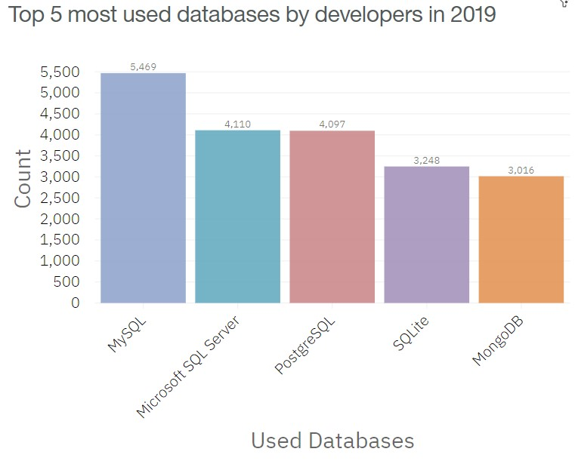
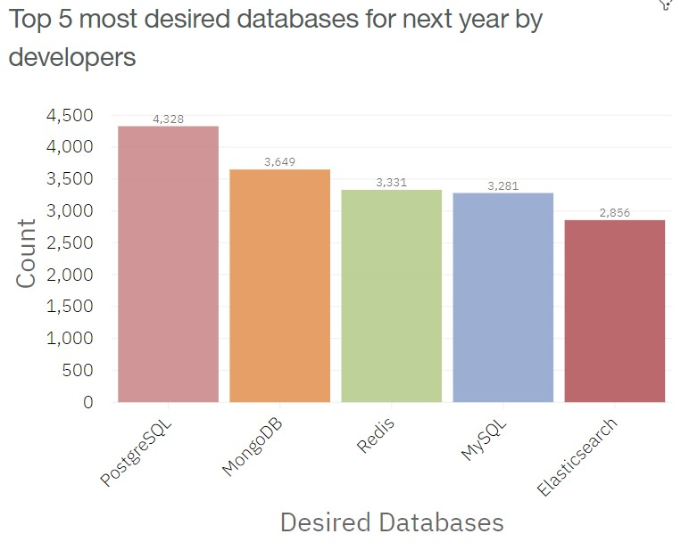
VISUALIZATION Database trends
Current Year
Next Year

Slide 17
FINDINGS & IMPLICATIONS Programming language trends
Findings
PostgreSQL and MongoDB are the most desired for next year DB, gaining better positions from the most used list
MySQL is the most used DB and still in the top 5 most desired for next year
Microsoft SQL server 2nd most used DB but not in the top 5 most desired for next year
SQLite in the top 5 most used DB but not in the top 5 most desired for next year
Implications
Give more focus on PostgreSQL and MongoDB as DB
Keep focus on MySQL DB
Give more focus to Redis and Elasticsearch rather than Microsoft SQL and SQLite

Slide 18
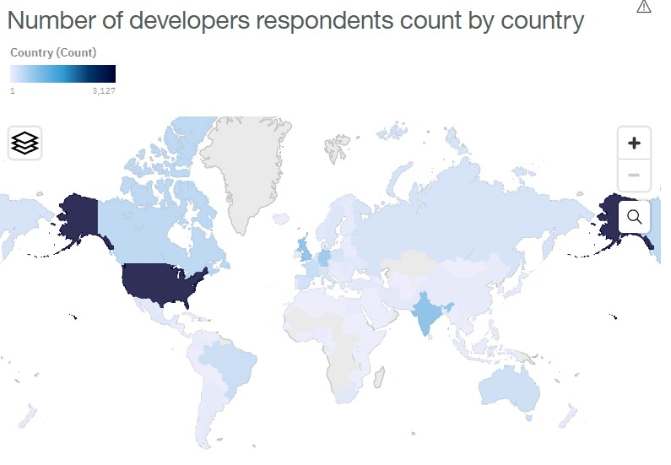
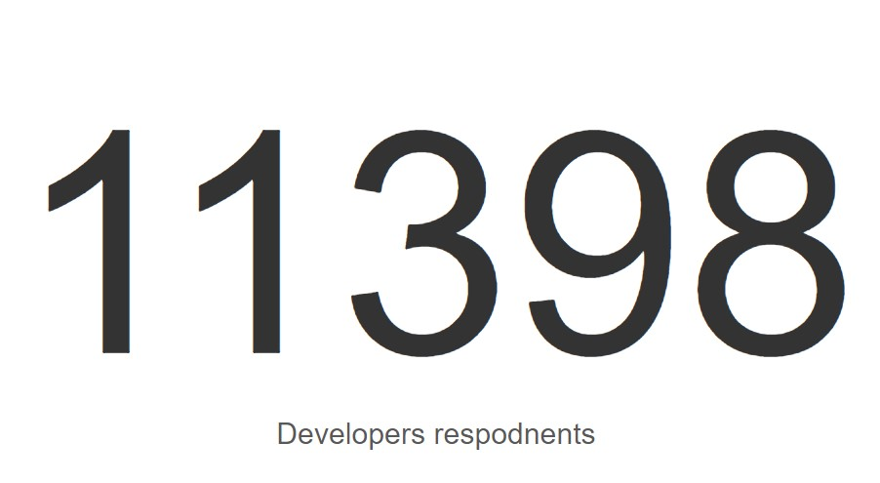
VISUALIZATION Demographics respondents
Total respondent developers
Respondent developers by country

Slide 19
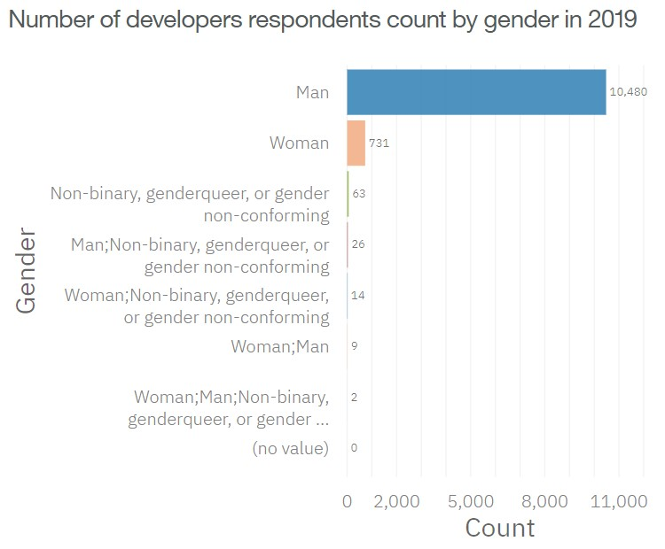
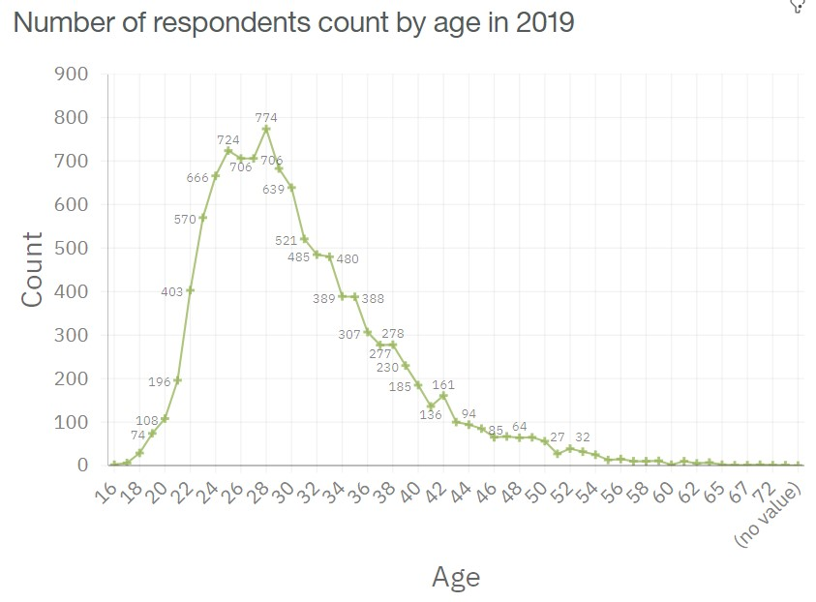
VISUALIZATION Demographics Age and Gender
Genders of respondent developers
Age of respondent developers

Slide 20
FINDINGS & IMPLICATIONS Demographics Age and Gender
Findings
92.5% of respondent developers are Men (10480)
6.5% of respondent developers are Women (731)
Majority of respondents were in the 20-40 age range
Age peak in 25-28 range
Implications
Not many Women developers
Either Stock Overflow is mainly known and used by young age range
Either developer are of young age

Slide 21
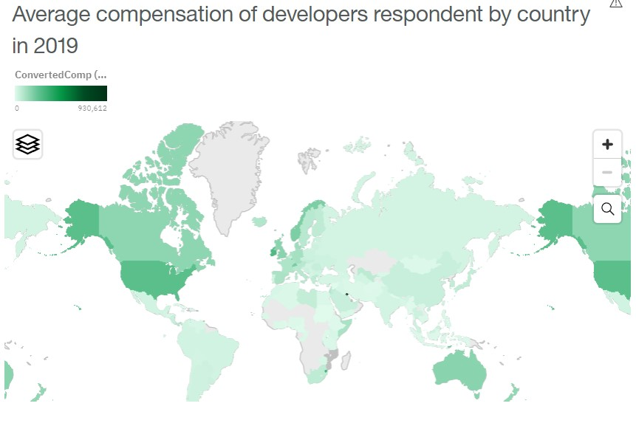
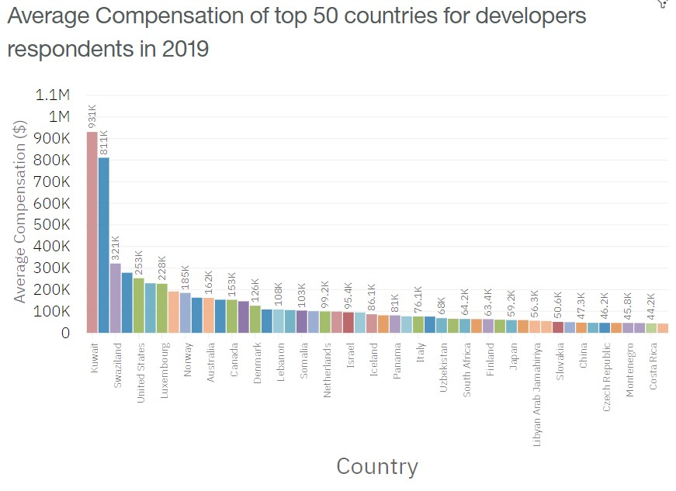
VISUALIZATION Demographics Compensation by country
Compensation (mean) by country
Compensation (mean) by country top 50
Compensation by most used language

Slide 22
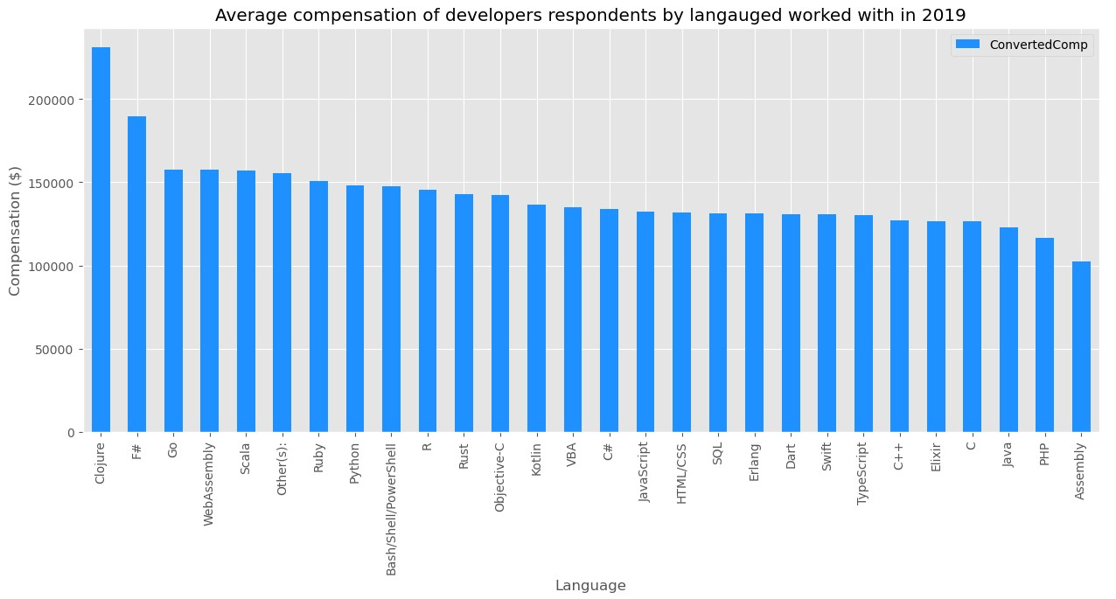
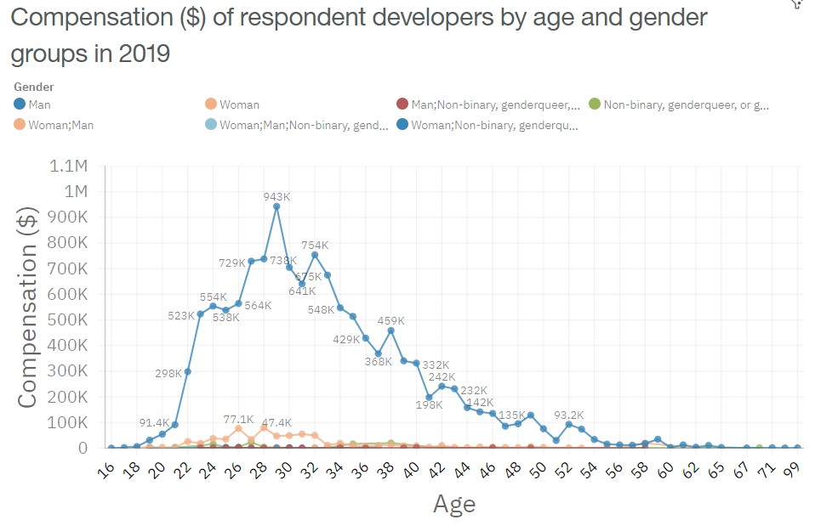
VISUALIZATION Demographics Compensation by age, gender and most used language
Compensation (mean) by language
Compensation by age and genders

Slide 23
FINDINGS & IMPLICATIONS Demographics Compensation by country age and gender
Findings
Top 3 countries with the highest average annual compensation are Kuwait, Switzerland, USA
Most paid developers are men
Most paid developers are between 25 - 35
Big disparities between men and women compensation, for each age group
Highest average compensations to developers who used Conjure and F#. Not deep disparities between the other languages
Implications
Not enough respondents from the other countries
Not enough female respondents
Similar compensation by language used

Slide 24


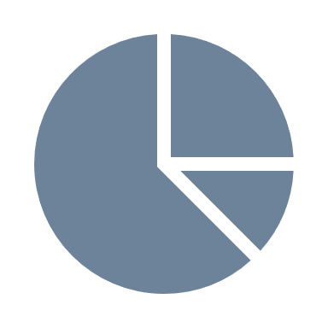
DASHBOARD Link
https://eu-de.dataplatform.cloud.ibm.com/dashboards/0a1df9d0-958b-4f64-baa4-ad920440ebc4/view/0365e1193eaa32d067d3eee407c829047e61775db4bbd10582817b4909627297f33f15c4c8281d0ed3190532f4bf165fc0
https://eu-de.dataplatform.cloud.ibm.com/dashboards/ab22463e-d212-4738-b5e3-f671302f8b23/view/053cdc7760ea2bca76fec8e407c829047e61775db4bbd10582817b4909627297f33f15c4c8281d0ed3190532f4bf165fc0

Slide 25
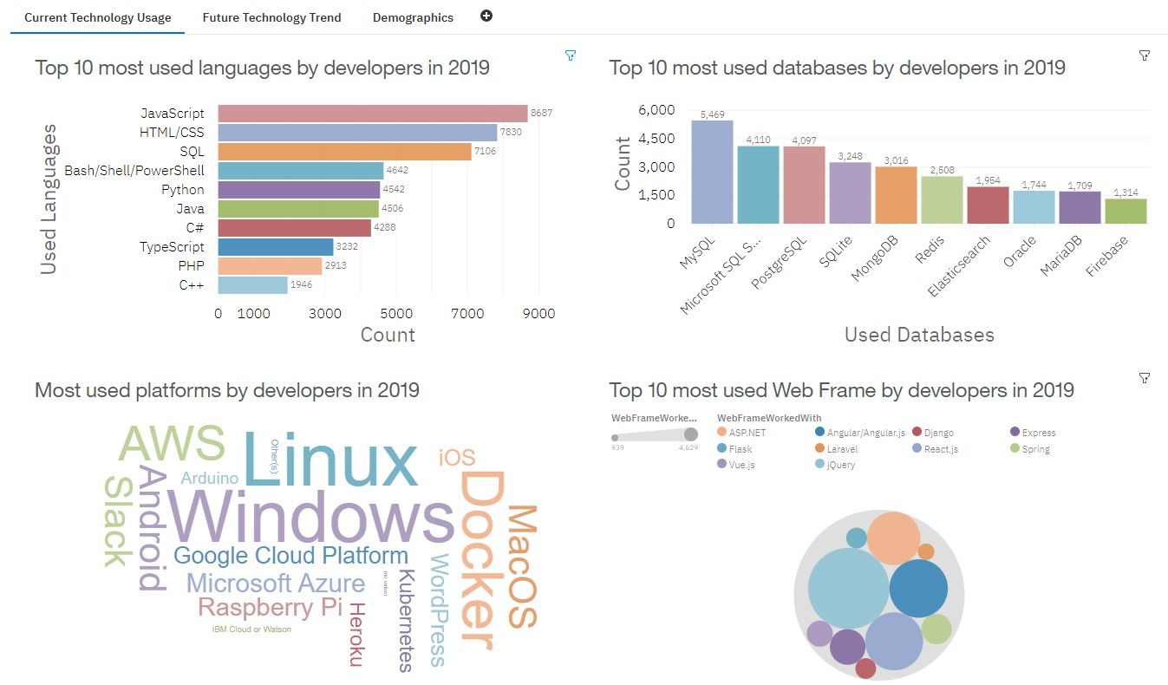
DASHBOARD Tab 1 Current technology

Slide 26
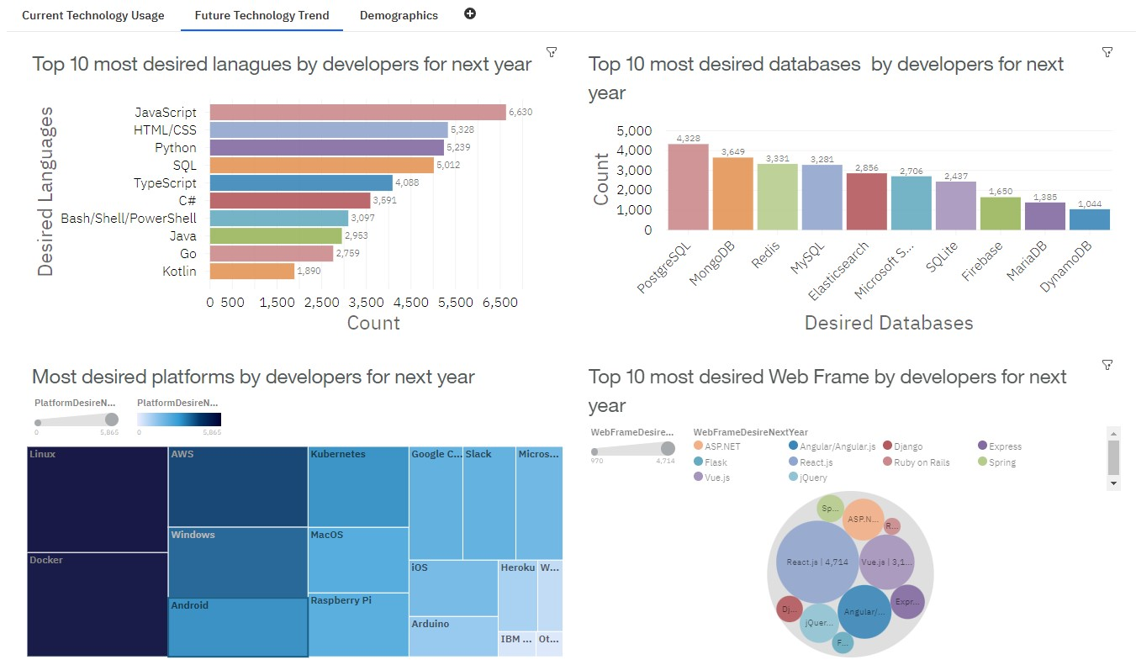
DASHBOARD Tab 2 Future technology

Slide 27
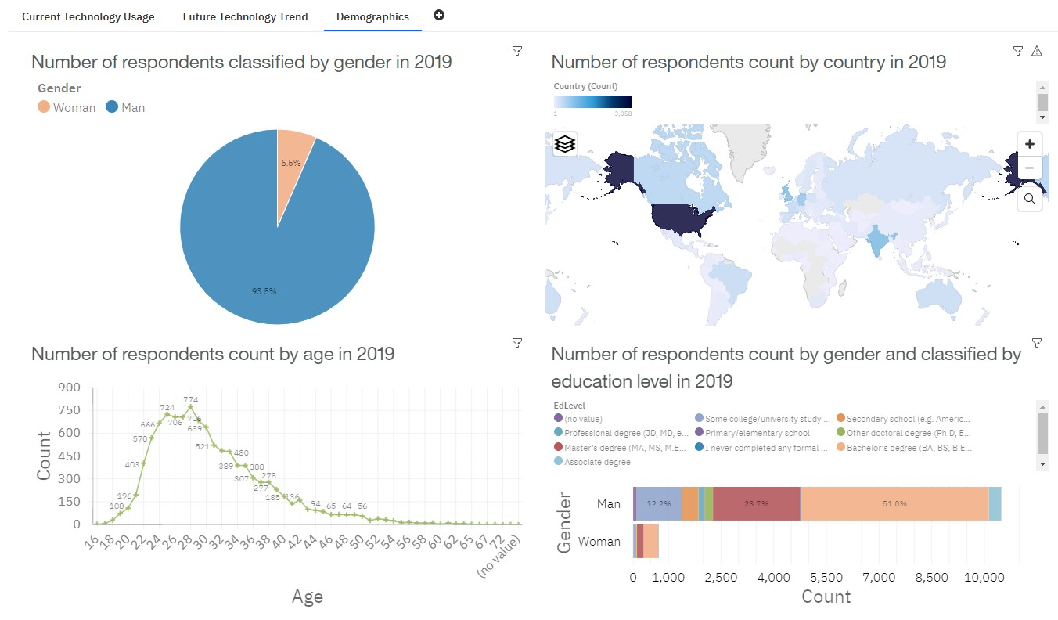
DASHBOARD Tab 3 Demographics

Slide 28
DISCUSSION

Slide 29

DISCUSSION
Trends of most used vs most desired for next year languages
Trends of most used vs most desired for next year databases
Developers respondents characteristics by age gender country compensation

Slide 30
FINDINGS & IMPLICATIONS Programming language trends
Findings
JavaScript and HTML/CSS are both the most used and most desired for next year languages
Python is the 3rd most wanted language to be learnt for the next year (5th of most used language)
SQL was the 3rd most used language, but decreased to 4th most desired language to be learnt
TypeScript replaces Bash/Shell/PowerShell in the top 5 desired languages
Implications
JavaScript and HTML/CSS continue to be languages to be learnt
Increase interest in the Opensource Python language
Slightly decrease interest in the SQL language
Give more focus on TypeScript rather than Bash/Shell/PowerShell

Slide 31
FINDINGS & IMPLICATIONS Programming language trends
Findings
PostgreSQL and MongoDB are the most desired for next year DB, gaining better positions from the most used list
MySQL is the most used DB and still in the top 5 most desired for next year
Microsoft SQL server 2nd most used DB but not in the top 5 most desired for next year
SQLite in the top 5 most used DB but not in the top 5 most desired for next year
Implications
Give more focus on PostgreSQL and MongoDB as DB
Keep focus on MySQL DB
Give more focus to Redis and Elasticsearch rather than Microsoft SQL and SQLite

Slide 32
FINDINGS & IMPLICATIONS Demographics Age and Gender
Findings
92.5% of respondent developers are Men (10480)
6.5% of respondent developers are Women (731)
Majority of respondents were in the 20-40 age range
Age peak in 25-28 range
Implications
Not many Women developers
Either Stock Overflow is mainly known and used by young age range
Either developer are of young age

Slide 33
FINDINGS & IMPLICATIONS Demographics Compensation by country age and gender
Findings
Top 3 countries with the highest average annual compensation are Kuwait, Switzerland, USA
Most paid developers are men
Most paid developers are between 25 - 35
Big disparities between men and women compensation, for each age group
Highest average compensations to developers who used Conjure and F#. Not deep disparities between the other languages
Implications
Not enough respondents from the other countries
Not enough female respondents
Similar compensation by language used

Slide 34
CONCLUSIONS

Slide 35

CONCLUSION
Languages to focus on: JavaScript HTML/CSS Python SQL
Databases to focus on: PostgreSQL MongoDB MySQL
Flatten the disparities between genders in number of developers
Flatten the disparities between genders in compensation of developers

Slide 36
APPENDIX

Slide 37

APPENDIX
Most used vs desired for next year platforms
Most used vs desired for next year web frames
Number of job postings per city in USA
Number of job postings per language in USA
Annual average compensation per language
Work location of developers in survey 2019

Slide 38
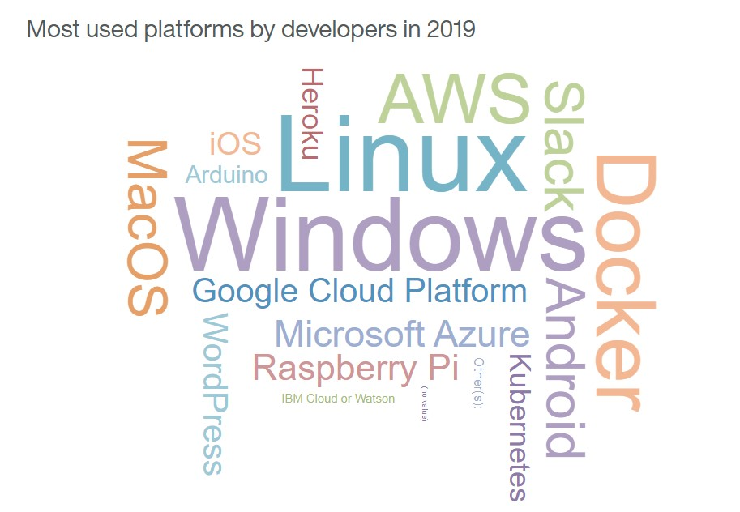
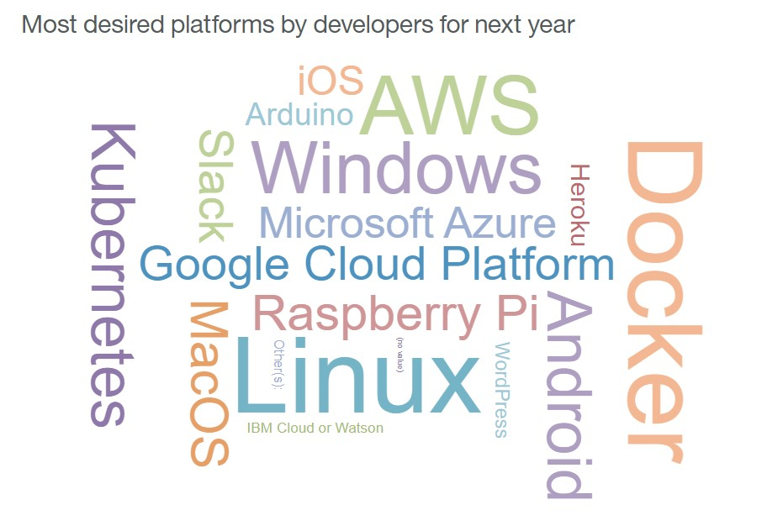
VISUALIZATION Platforms trends
Current Year
Next Year

Slide 39
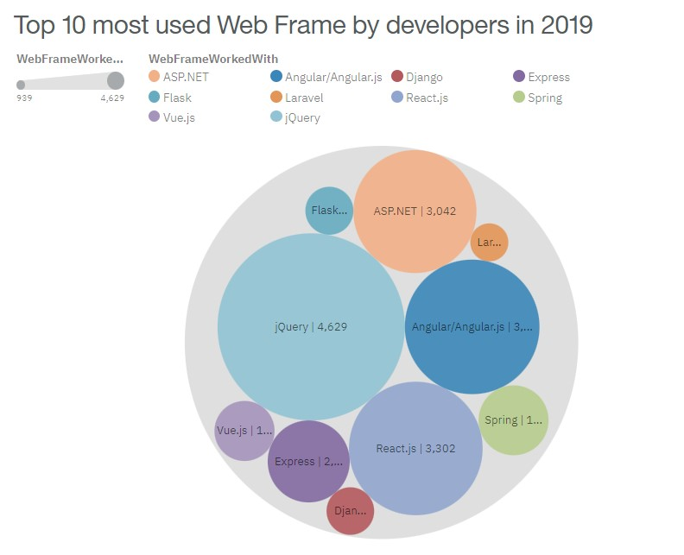
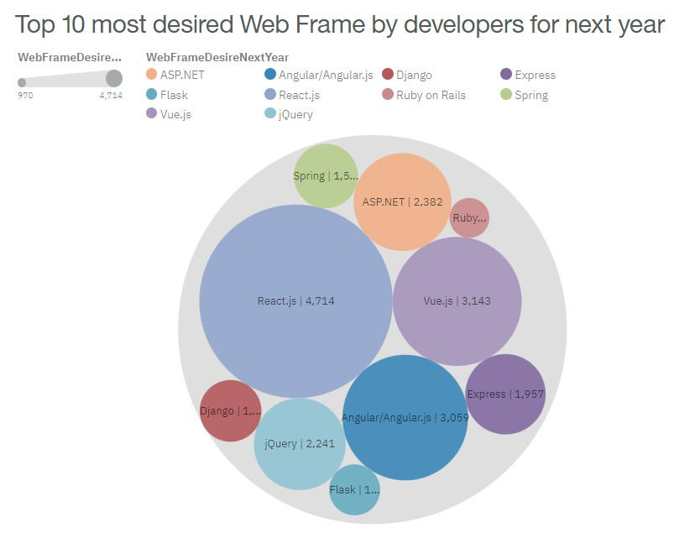
VISUALIZATION Web frames trends
Current Year
Next Year

Slide 40
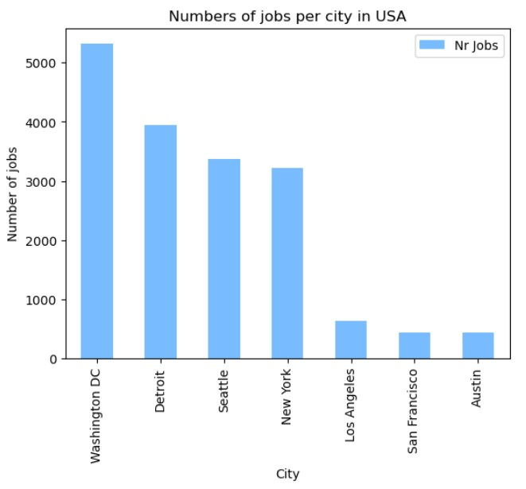
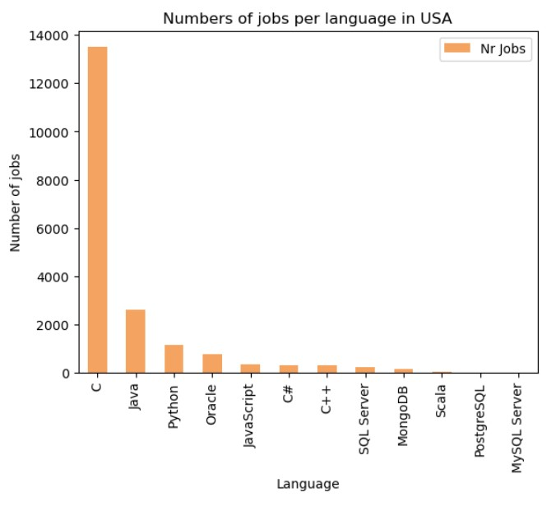
VISUALIZATION Job postings

Slide 41
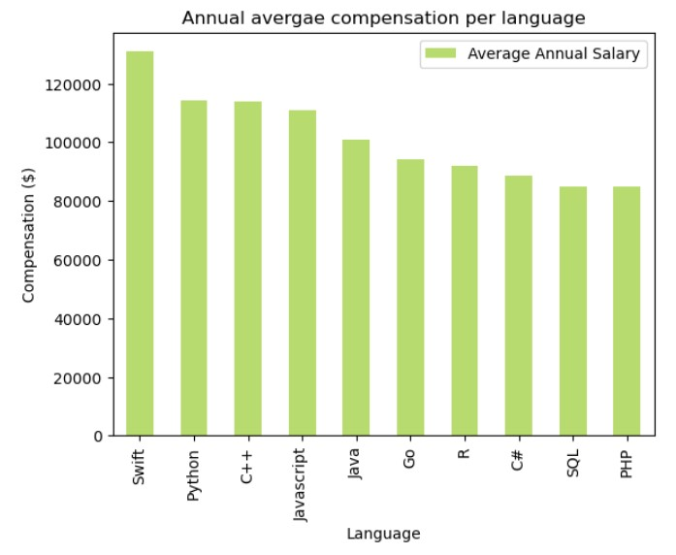
VISUALIZATION Annual average compensation per language

Slide 42
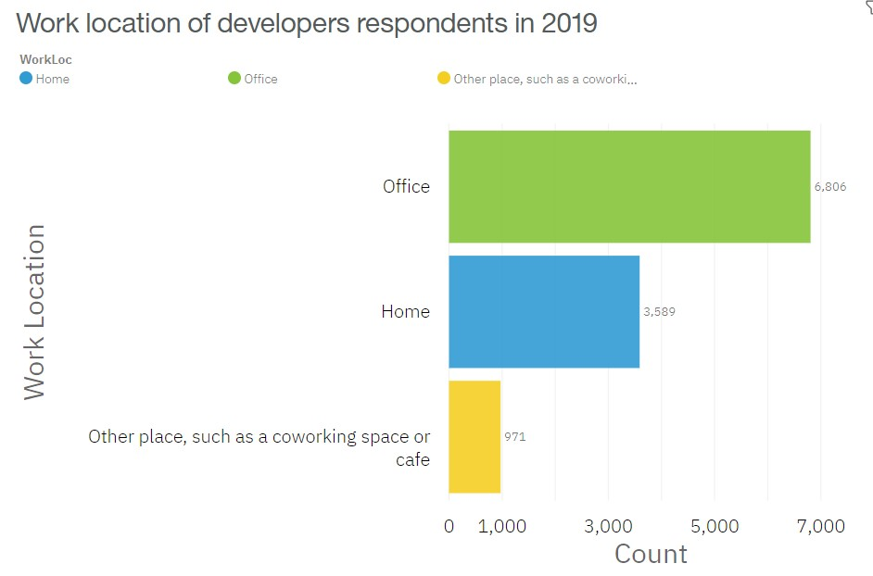
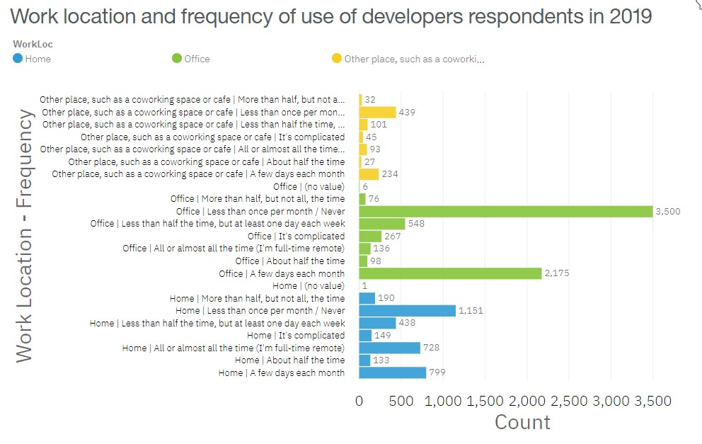
VISUALIZATION Work location
Work location of developers respondents
Work location and use of developers respondents

